Slide 1

A Skeptics Guide to React
A different kind of React talk

Slide 2
What this talk is about:
React (duh)
The History of React and SPA vs. MPA wars
Why the industry uses React
The fundamentals how and why React is what it is
State vs. Props
Class components vs. Functional components
Lifecycle methods vs. State Hooks
(very briefly) React Native

Slide 3
What this is NOT
A sales pitch for React
“Why your next app should be React”
An in-depth guide to all things React
State management tools
Fragments
Context
Refs
Most of React Native
If you want to leave for a better talk, now is the time...

Slide 4
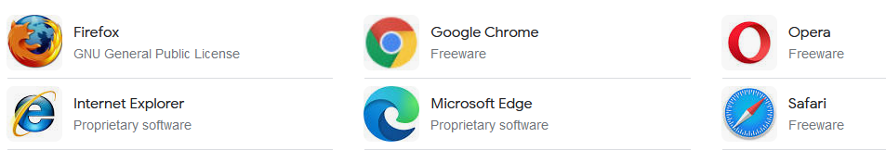
Subject to change over time..
Web development changes fast
The same code on the same javascript can run entirely different because of browser changes
This said here about “speed” and “faster” can change entirely because of how browsers do things in the future.

Slide 5

Who is this for?
Is this you?
“I’ve worked on React but really don’t know why/how it works”
“I don’t know why we are or should be using React.”
“It works, but I don’t know why.”

Slide 6
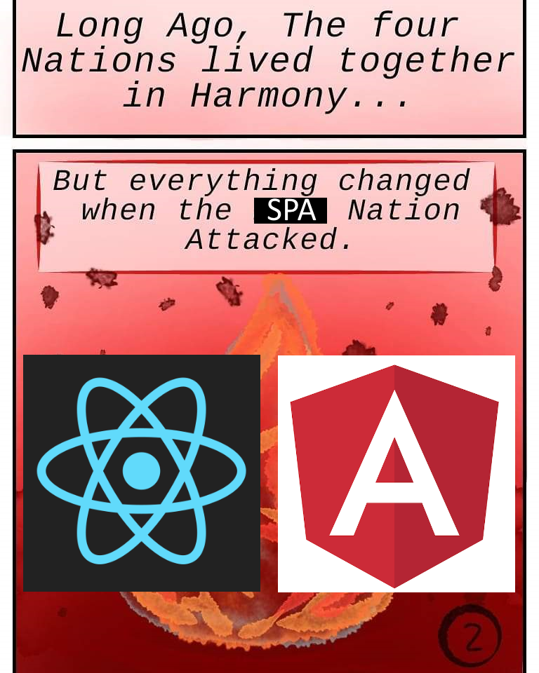
What is React?

Slide 7
The SPA vs. MPA war of 2010s
React is an outgrowth of the Single Page Application (SPA) trend of the 2010s
In this period a lot of developers pitched and developed around SPAs in place of traditional Multi Page Applications (MPAs)
SPAs were pitched to be “faster, more capable, and a better user experience”
SPAs were also pitched as to be the primary platform of all user applications

Slide 8
What is an MPA?
MPA is a Multi Page Application
It is how websites have worked from the beginning
A web application that navigates different functionality through requesting entirely new HTML pages from the server through URL routing
Examples include:
www.microsoft.com
www.amazon.com
www.wikipedia.com

Slide 9
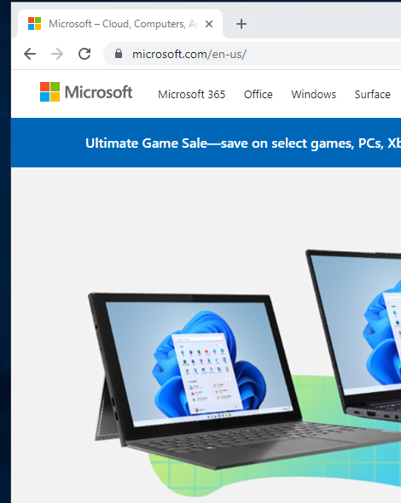
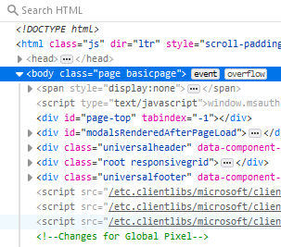


How an MPA Works
www.microsoft.com

Slide 10
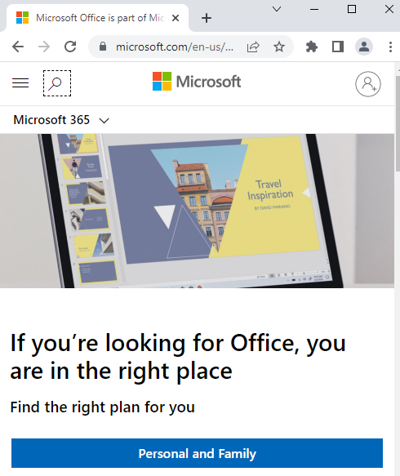
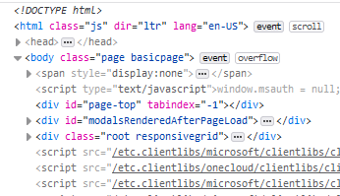
How an MPA Works pt.2
www.microsoft.com/office

Slide 11
What is a SPA
SPA is a Single Page Application
A relatively new way of presenting a website
A web application that upon navigating a page, the server sends the user JavaScript to run as the set of instructions to navigate and render the page on their client browser.
Examples include:
Gmail
Facebook
Twitter

Slide 12
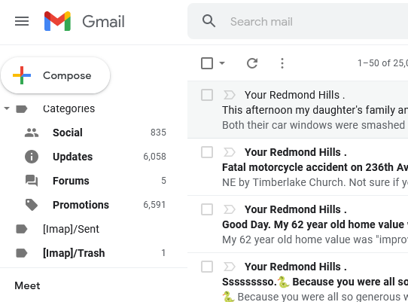


How a SPA works
www.gmail.com

Slide 13
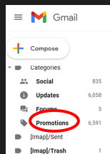
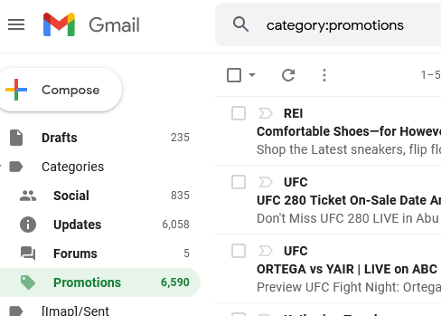

How a SPA works

Slide 14
MPA vs. SPA
Multi Page Application
Single Page Application
Pros
Faster first page load
Naturally stateless
Built in routing
Lower system requirements
Cons
Slower over multiple page loads
Offline is hard
Less capable UI
Pros
Faster overtime
Better offline potential
More capable UI
Cons
Slow first page load
Higher system requirements
Stateful nature makes it harder to debug
Routing is hard

Slide 15
Why React? But Angular first.
Google’s Angular was the competing SPA platform at the time
A Framework
A much larger initial page load
Assumed the only way you rendered things on the page used Angular
Strongly opinionated
Best suited for large enterprise applications (one where someone would use for 8 hours a day)
Less performant due to using the real DOM (more on this later)*
Also this is not necessarily the case today

Slide 16
Really, Why react?
React provided an attractive alternative
Library not a framework
A lighter weight (at the time) faster initial page load
Does not assume React is the only way you are rendering things on page
You can use React in an MPA as well as a SPA
store.microsoft.com is like this
Missing features scalable with third party addons
React router
Redux
Ultimately less “opinionated”
Virtual Dom
Trades memory usage for fast rendering of UI

Slide 17
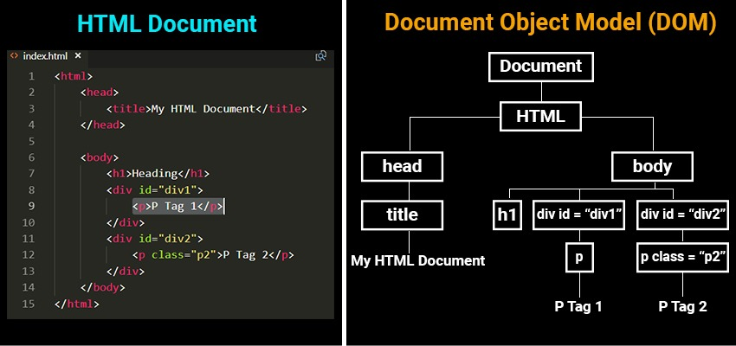
The DOM
DOM = Document Object Model
DOM is just a JSON representation of the HTML
Allows you to manipulate the HTML as object properties
https://simplesnippets.tech/what-is-document-object-modeldom-how-js-interacts-with-dom/

Slide 18
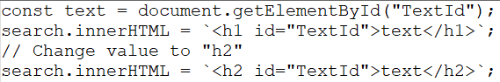
“The DOM is slow”

Slide 19
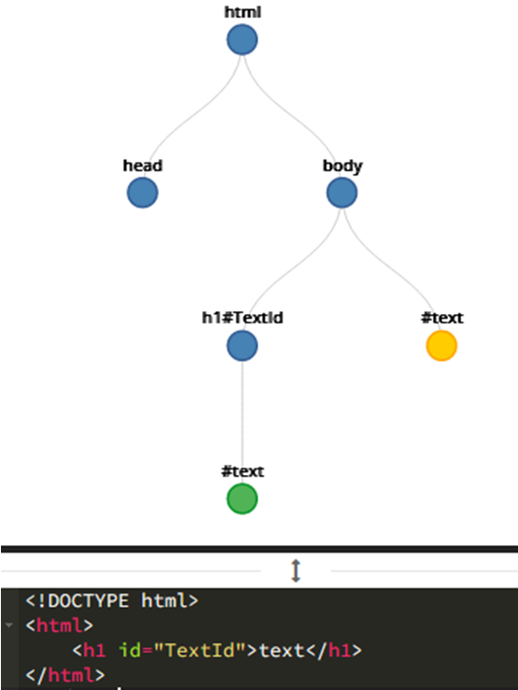
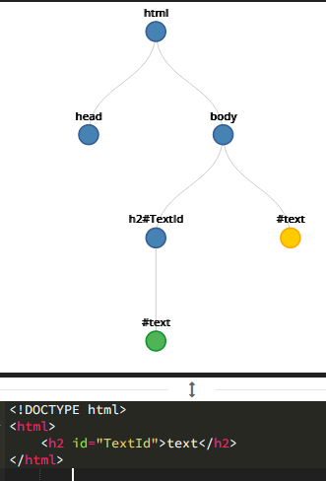
DOM Update

Slide 20
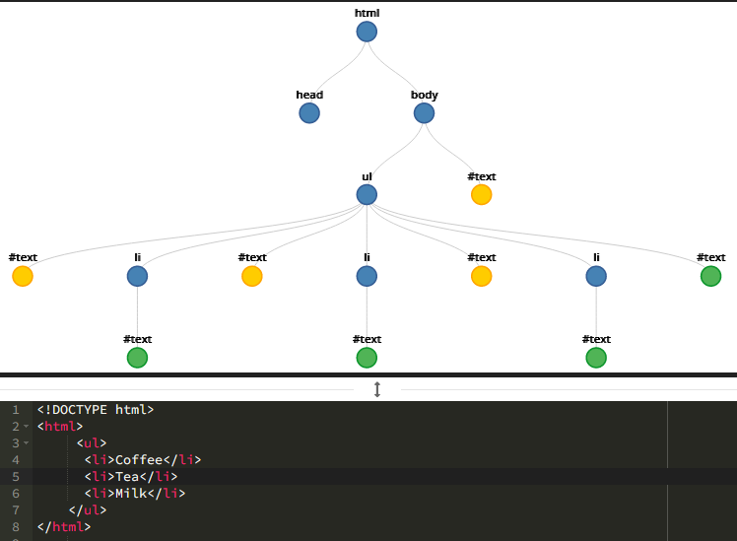
DOM to Scale

Slide 21
The Virtual DOM
React uses what’s called “The Virtual DOM”
It’s a copy of the DOM in memory
It’s “fast” because it doesn’t render
It compares the “Real DOM” vs. “Virtual DOM” to determine what changed and what changes to make
Process called “reconciliation”
It makes minimal changes for rendering

Slide 22
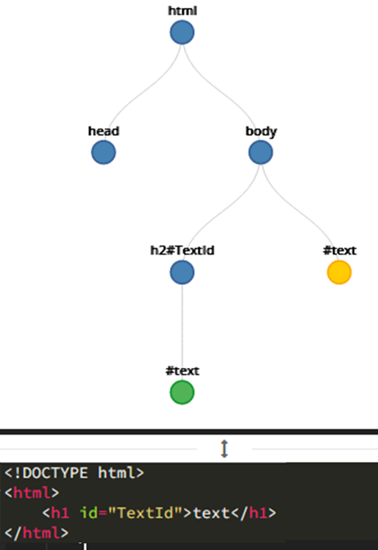
Virtual DOM Reconciliation
Virtual Dom
Real Dom after “reconciliation”
Real Dom

Slide 23
Why do I need to know?
The components in React are written from the perspective of the Virtual DOM
React code is structured to do the “lazy” thing and replace the component entirely.
Let reconciliation handle efficient rendering

Slide 24

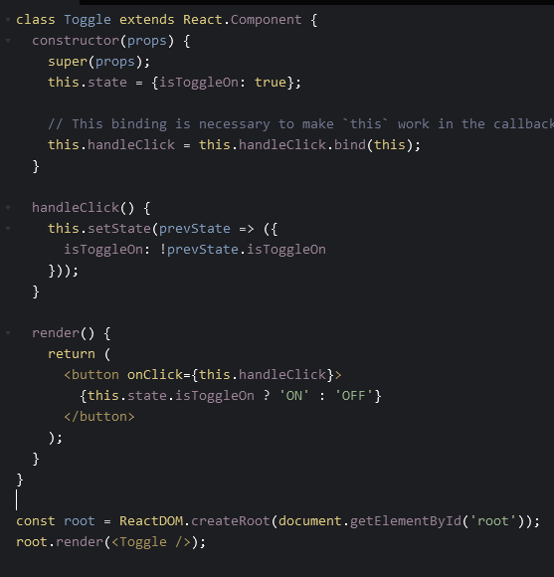
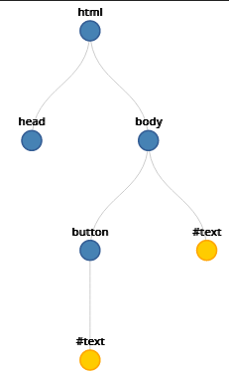
What is react doing?
Virtual Dom

Slide 25
You don’t see any of this
Virtual Dom
Real Dom after “reconciliation”
Real Dom

Slide 26
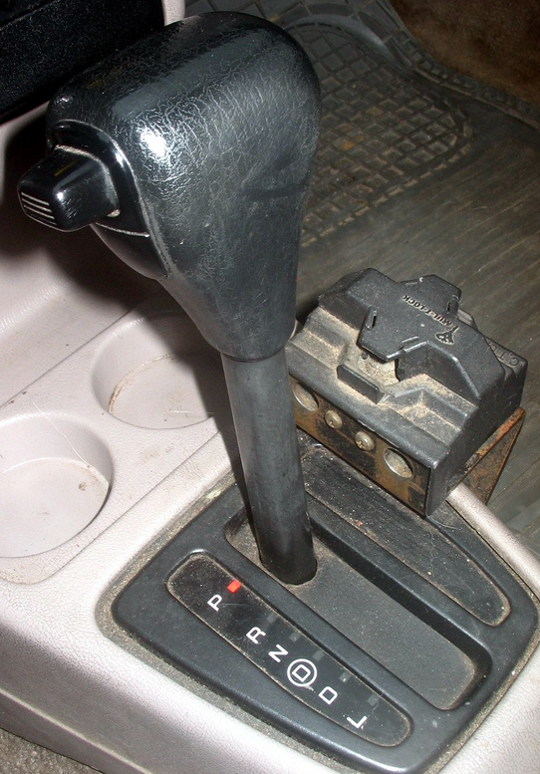

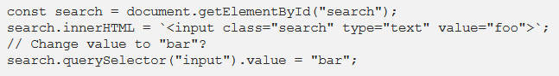
“The Virtual Dom is Faster!”
The Virtual DOM isn’t actually faster
It just makes it easy to go fast
Truth is… We are just lazy
https://medium.com/@hayavuk/why-virtual-dom-is-slower-2d9b964b4c9e

Slide 27
How is React formed?
React represents its renderable and manipulatable HTML components in JSX/TSX
Think of it as Javascript/Typescript + HTML
Unsurprisingly the HTML looking stuff represents closely to the HTML to be rendered on screen

Slide 28
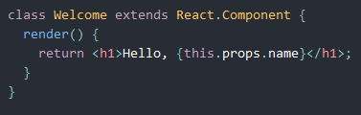
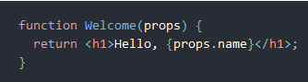
Class vs Functional Components
Class Component
Functional Component

Slide 29
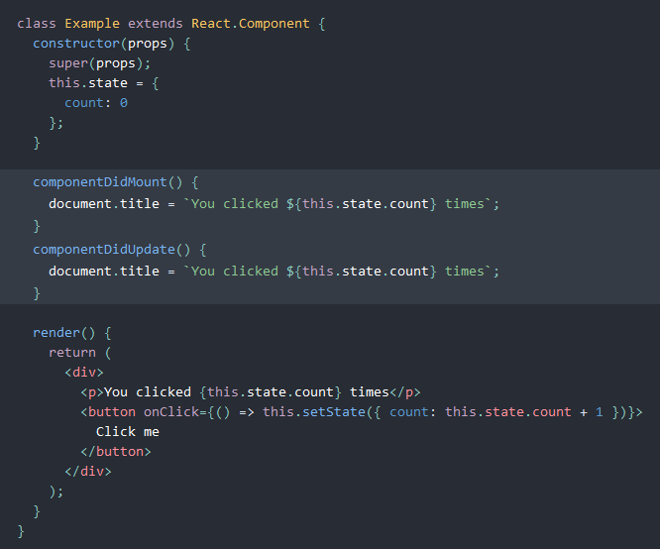
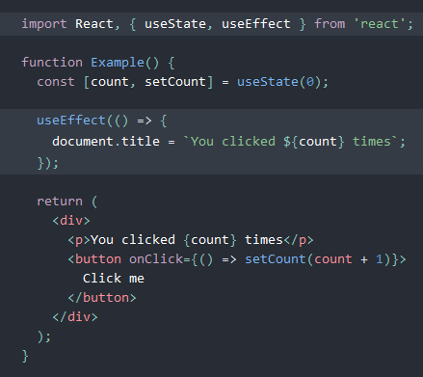
Real Class vs Functional Components
Class Component
Functional Component

Slide 30
Differences
Class Component
Functional Component
An Object-Oriented way of representing a component:
A “living thing”
Born, lives and dies
componentDidMount
onChange
componentWillUnmount
An “intuitive" way of thinking
Understandable by anyone used to lifecycle UI frameworks.
An “in-out” box, that you feed it props, it spits out a component:
Every change you make kills the old component and gives you a new one
Represents how the Virtual DOM really works.
Understanding requires knowing how React works.

Slide 31
State and Props
React Components have 2 ways of storing data
State
Props (short for properties)

Slide 32
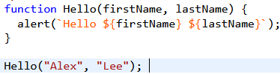
Props
Props (Properties) are easiest thought as “parameters” for a component
Basic Javascript

Slide 33
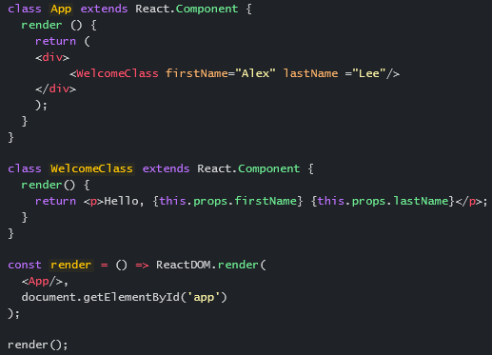
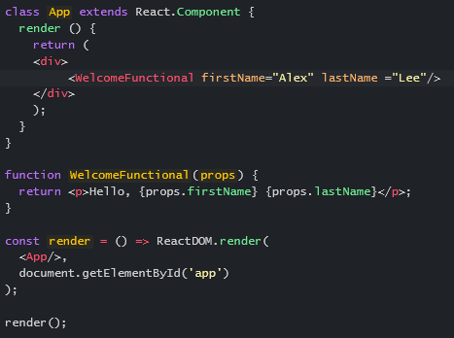
Props cont.
Class Component
Functional Component

Slide 34
Properties of Props
A few things to keep in mind
Immutable*/Read only
You cannot* (shouldn’t) change them inside the component once they are passed
setProps == bad (deprecated)
Can only be passed down from parent component to child
Props are default defined as type object

Slide 35
Why you can’t pass “up” props/state
Components are meant to be reusable
Component A
-State
-props
Component B
-State
-props
Component B
-State
-props
Component C
-State
-props
Component C
-State
-props
Component C
-State
-props

Slide 36
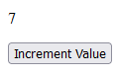
Increment a number Button

Slide 37
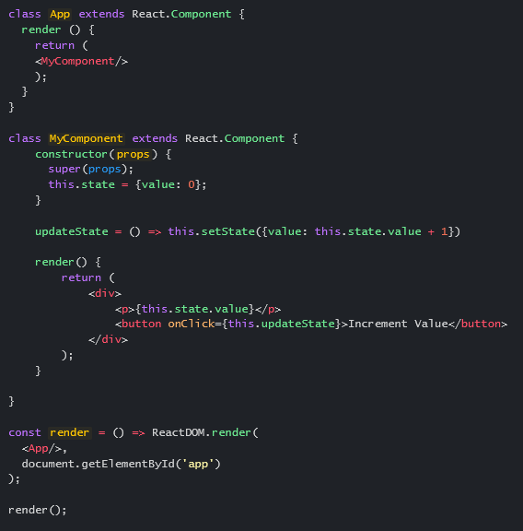
State
Class Component
State is easiest thought as an object private variable
Is mutable within the component
Shouldn’t* be publicly accessible from parents
Careful about createRef()
Retains data between renders
Notes:
class App extends React.Component {
render () {
return (
<MyComponent/>
);
}
}
class MyComponent extends React.Component {
constructor(props) {
super(props);
this.state = {value: 0};
}
updateState = () => this.setState({value: this.state.value + 1})
render() {
return (
<div>
<p>{this.state.value}</p>
<button onClick={this.updateState}>Increment Value</button>
</div>
);
}
}
const render = () => ReactDOM.render(
<App/>,
document.getElementById('app')
);
render();

Slide 38
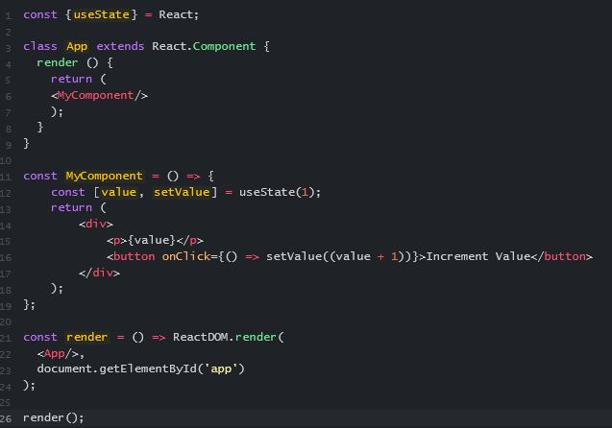
Functional component “State” is weird…
The point of Functional components was to make them as stateless as possible
But stateless programs don’t “do” anything
So, we have to add state…
But functions don’t have state or object permanence
useState creates state data in some global context that the library promises that the associated component only accesses.
It’s weird…

Slide 39

Lifecyle methods
Class component lifecycle methods are pretty self explanatory
Constructor()
Render()
componentDidMount()
componentDidUpdate()
componentWillUnmount()

Slide 40
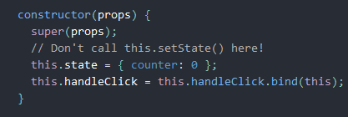
constructor()
“I’m not ready yet, let me get ready”
Set initial state values
Event handler binding (Onclick events)
Happens before “render()” is called

Slide 41
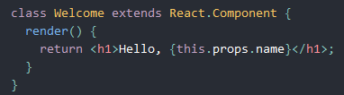
render()
“This is what I look like, put me on stage!”
Make the pretty stuff on screen
This method runs anytime props or state changes
Do not change state in your render function

Slide 42
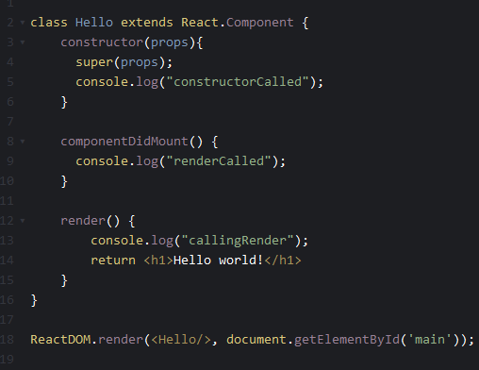
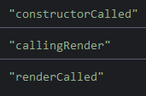

componentDidMount()
“Once I’m on stage, I do ‘this’ first!”
method runs after first render() has completed

Slide 43
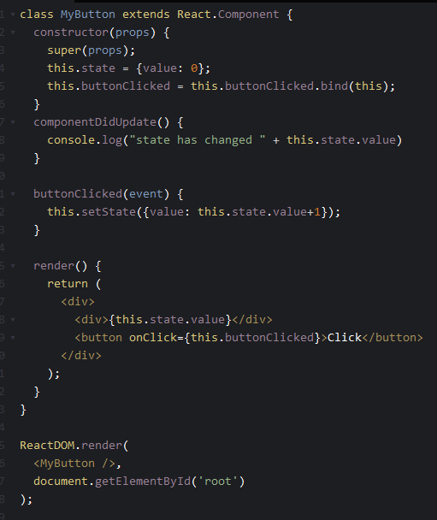
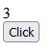
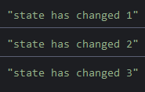
componentDidUpdate()
“if anything changes, do this.”
“update” is anytime the component’s state or props changed
Only after the first render
Any calls are made post render()

Slide 44
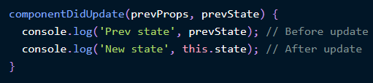
prevProps, prevState
ComponentDidUpdate has default parameters for prevProps and prevState
Gets props or state before the update happens
Primarily use for comparing previous state to current state

Slide 45
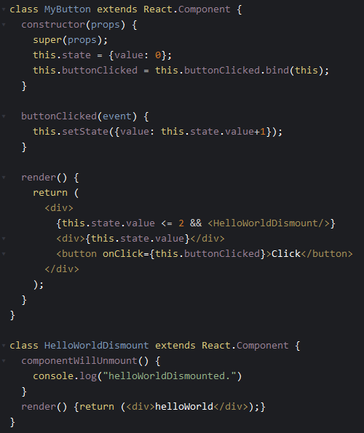
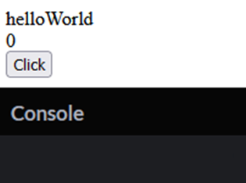
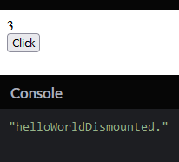
componentWillUnmount()
“My encore before I leave offstage!”
Notes:
class MyButton extends React.Component {
constructor(props) {
super(props);
this.state = {value: 0};
this.buttonClicked = this.buttonClicked.bind(this);
}
buttonClicked(event) {
this.setState({value: this.state.value+1});
}
render() {
return (
<div>
{this.state.value <= 1 && <HelloWorldDismount/>}
<div>{this.state.value}</div>
<button onClick={this.buttonClicked}>Click</button>
</div>
);
}
}
class HelloWorldDismount extends React.Component {
componentWillUnmount() {
console.log("helloWorldDismounted.")
}
render() {return (<div>helloWorld</div>);}
}
ReactDOM.render(
<MyButton />,
document.getElementById('root')
);

Slide 46

Effect Hooks, useEffect
Functional components don’t use lifecycle methods
The “equivalent” are effect hooks (useEffect)
It’s best to think effect hooks as a totally different way compared to lifecycle methods

Slide 47
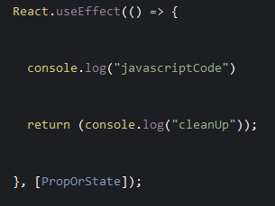
The anatomy of useEffect()
JavaScript to
run on change.
JavaScript that stages to run before the next useEffect (like a “finally” statement)
Prop or state that changed to initiate the effect

Slide 48
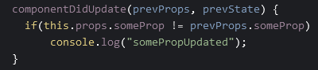
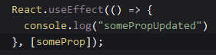
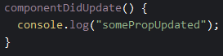
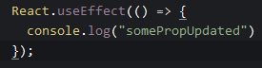
componentDidUpdate vs. useEffect
componentDidUpdate
useEffect
No second parameter means: “run this effect for every change”

Slide 49
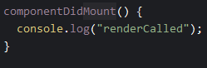
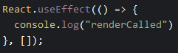
componentDidMount vs. useEffect
componentDidMount
useEffect
Empty array means run once

Slide 50
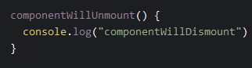
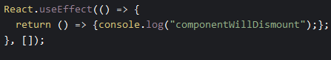
componentWillUnmount vs. useEffect
componentWillUnmount
useEffect
Javascript that stages to run before the next useEffect (like a “finally” statement)

Slide 51
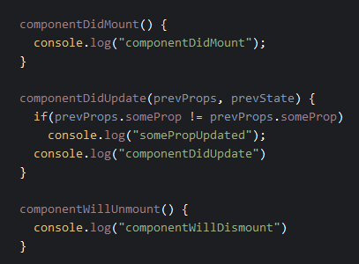

Class component vs. useEffect
Class component
useEffect
You can have multiple useEffect statements

Slide 52



useEffect conditional cleanup
Class Component
useEffect
Initial Render
Props Or State Updated
Props Or State Updated

Slide 53
Lifecycle vs. effect hooks
Class Lifecycle Methods
Functional Effect Hooks
Pros
Easy to understand
Lifecycles explicitly named
Concepts translatable to other UI frameworks
Does not require intimate knowledge of innerworkings of React
Cons
Code duplication is likely between lifecycles
More verbose code
Possibly less performant
Less flexible
Pros
Less verbose code
Less code duplication
More flexible with one method
Cons
Hard to understand?
Concept only makes sense if you understand how React works
Cleanup function is really hard to understand by looking at it
How state exists in a stateless functional component is hard to reconcile conceptually

Slide 54

React Native
https://dev.to/elaziziyoussouf/forms-in-react-native-the-right-way-4d46

Slide 55

What is React Native
React Native is the idea of putting React outside a web browser and primarily on phones
Sold on the idea that concepts carry over
Developers supposedly can cross over “easily”
Works on everything

Slide 56
React Native Differences
React
React Native
For Web browsers
Full JS library compatibility
JSX that looks like HTML
No special tools for builds. (just nodeJS)
Platform concerns are browsers
For phones (iOS/Android)
JS libraries must be built for native
JSX is not the same (no HTML)
Requires special tools like Android Studio or xCode to build
Cross platform iOS vs Android concerns

Slide 57

No I didn’t cover everything
There is a lot more..
Context
Error Boundaries
Refs
Portals
Typescript and .tsx
This should be enough to get you going…

Slide 58

The End

Slide 59
Copyright Notice
Copyright 2022 ALAN WONG
Permission is hereby granted, free of charge, to any person obtaining a copy of this document and associated documentation files (the "document"), to deal in the document without restriction, including without limitation the rights to use, copy, modify, merge, publish, distribute, sublicense, and/or sell copies of the document, and to permit persons to whom the document is furnished to do so, subject to the following conditions:
The above copyright notice and this permission notice shall be included in all copies or substantial portions of the document.
THE document IS PROVIDED "AS IS", WITHOUT WARRANTY OF ANY KIND, EXPRESS OR IMPLIED, INCLUDING BUT NOT LIMITED TO THE WARRANTIES OF MERCHANTABILITY, FITNESS FOR A PARTICULAR PURPOSE AND NONINFRINGEMENT. IN NO EVENT SHALL THE AUTHORS OR COPYRIGHT HOLDERS BE LIABLE FOR ANY CLAIM, DAMAGES OR OTHER LIABILITY, WHETHER IN AN ACTION OF CONTRACT, TORT OR OTHERWISE, ARISING FROM, OUT OF OR IN CONNECTION WITH THE document OR THE USE OR OTHER DEALINGS IN THE document.

